Slide 1
High-Speed Transceivers and Serial Transmission and Reception
In this lecture we will look at high-speed transceivers, the most recent and hottest development in FPGAs
Communication protocols are all the rage, from Ethernet to fiber optic communications to inter-processor communications
Transceivers are an "analog" I/Os, of many gigabits per second
Easily the most complicated FPGA structure

Slide 2
Learning Objectives
Learn about transceivers in FPGAs
Learn about line codes used for transceivers
Learn about block codes, in particular 8b/10b which is very widely used
Use 1Gbit/Sec Ethernet as a case study to tie everything together

Slide 4
System Synchronous

Slide 5
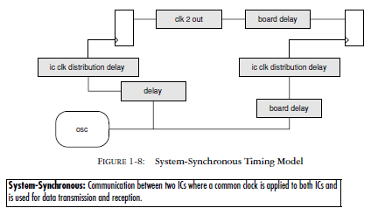
System Synchronous Timing

Slide 6
The problem with System Synchronous
For years most signal delays were ignored because they were so small compared to the available time.
But as speeds increased, managing delays for multiple data bits became more difficult, then impossible.
One way to improve the problem was to send a copy of the clock along with the data. This method is called source-synchronous and it greatly simplified the timing parameters

Slide 7
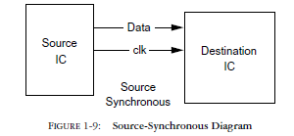
Source-Synchronous

Slide 8
Source Synchronous Timing

Slide 9
The problem with Source Synchronous
Source-synchronous design results in a marked increase in the number of clock domains (now every data bus has its own clock).
This introduces timing constraint and analysis complications for devices such FPGAs with limited clock buffers, and ASICs where each clock tree must be custom designed
The problem is aggravated on large parallel buses where board design limitations often force the use of more than one forwarded clock per data bus (matching delays for all traces is not possible). Hence, a 32-bit bus may require four, or even eight forwarded clocks.

Slide 10
Transmission system General
Data
Flip
Flop
D
Q
Clock
C
@ 1 Gbps
= 1 ns
= 20 cm
Notes:
10

Slide 11
Transmission system Propagation Delay
Data
Flip
Flop
D
Q
Clock
C
Unequal propagation delay
10 cm
@ 1 Gbps
?
?
?
?
Notes:
11

Slide 12
Self Synchronous

Slide 13
Self-Synchronous: The clock is embedded in the data (we’ll see how)

Slide 14
Parallel to Serial Conversion

Slide 15
Serial to Parallel Conversion

Slide 16
Clock/Data Recovery (CDR)

Slide 17
Figure 21-02

Slide 18
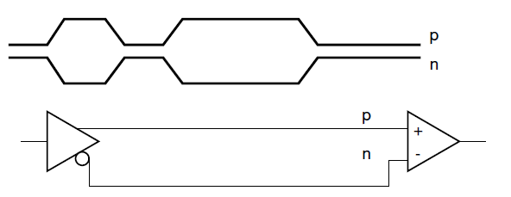
Differential Signaling

Slide 19
Figure 21-04

Slide 20
Why differential signaling helps
Figure 21-03

Slide 21
For differential signaling to work
Traces on the PCB need to be close together, or traces must be adjacent or twisted in a cable
Length of traces must be the same
Material/environment/shielding of signals must be the same
Good matching/high speed design principles need to be obeyed (to avoid reflections, crosstalk, etc.)

Slide 22
Differential Signal PCB Trace Types

Slide 23
Why layout is important
When traces are close together and always with opposite currents, the area outside the traces sees a current of 0
Effective combined radiated field is nearly 0, reducing EMI and crosstalk

Slide 24
Control Information – Parallel Data

Slide 25
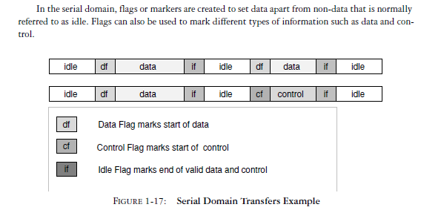
Control Information – Serial Data

Slide 26
Control Information – Serial Data
Control information is passed on from higher protocol layers – not physical layer which is “dumb”
Usually done via 8b10b control characters (that we will discuss shortly)
Additional complexity is present if multiple serial data links need to work together

Slide 27
Gigabit Serial Links
What is the chief advantage of gigabit serial I/O? Speed.
For getting data on and off of chips, boards, or boxes, nothing beats a high-speed serial link. With wire speeds from 1 to 12 Gb/s and payloads from 0.8 to 10Gb/s, that is a lot of data transfer.
And with fewer pins, no massive simultaneous switching output (SSO) problems, lower EMI, and lower cost, high-speed serial is the clear choice.

Slide 28
Multigigabit transceivers (MGTs)
MGT: Multi-Gigabit Transceiver—Another name for multi-gigabit Serializer/Deserializer (SERDES).
Receives parallel data and allows transportation of high bandwidth data over a serial link.
Multigigabit transceivers (MGTs) are the way to go when we need to move lots of data fast.

Slide 31
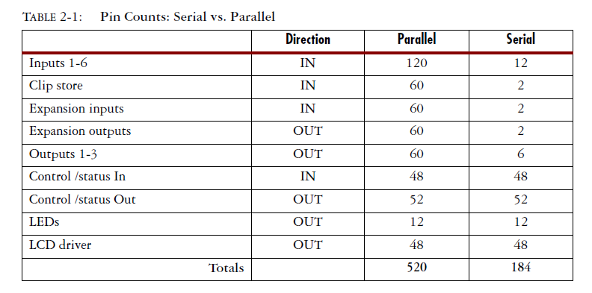
MGTs reduce pin count

Slide 32
Simultaneous Switching Outputs
Altera calls this SSN (Simultaneous Switching Noise)
A designer should consider SSO when using single-ended parallel buses.
However, some of those outputs are going to toggle at the same time.
When too many switch simultaneously, ground bounce creates a lot of noise.
For MGTs – less lines switch simultaneously

Slide 33
EMI (Electromagnetic Interference)
Electromagnetic emissions of single-ended lines are worse than differential signals
Since layout of the differential signals are routed together, and always are opposite, The differential signal emissions “cancel each other out”
EMI is a big issue for FCC approval to sell your product and to avoid crosstalk issues and related failures

Slide 34
Cost Advantages of MGT
Using MGTs will often result in lower overall system costs.
With a smaller, cheaper package, the connectors can have fewer pins and the board design may be simpler as well.
Another benefit of using MGTs is the availability of predefined protocols and interface standards. Designs already exist for many different needs.

Slide 35
MGT Disadvantages
Careful layout of traces is important
Impedance control of PCB is important
Termination is important
Analog effects need to be taken into account (we will discuss those shortly)
Chips with MGTs tend to be more expensive (but this is often offset by lower cost of overall design)

Slide 36
Uses of MGTs
Initially, gigabit SERDES was confined to the telecommunications industry and to a few niche markets such as broadcast video.
Today, MGT applications appear in every section of the electronics industry — military, medical, networking, video, communications, etc.
They are also being used on printed circuit board (PCB) assemblies through backplanes and between chassis. MGTs are critical to the future of electronics.

Slide 37
Some common MGT Protocols
FiberChannel (FC)
PCI Express
RapidIO Serial
Advanced Switching Interface
Serial ATA (SATA)
1-Gb Ethernet
10-Gb Ethernet (XAUI)
Infiniband 1X, 4X, 12X
USB 3.0
Thunderbolt

Slide 38
FPGA as a protocol converter

Slide 39
Chip-to-Chip Communications
SERDES (SERializer/DESerializer – which include both gigabit links and slower links which operate similarly but have a speed of less than 1 Gbit/sec) were initially used to talk box-to-box. But it exploded (last decade) into the marketplace because of how nicely it handles chip-to-chip communication on the same circuit board.
Chip-to-chip communication had previously been almost exclusively a parallel domain. The amount of logic needed to serialize and deserialize far outweighed any savings that come from pin count reduction.

Slide 40
Chip-to-Chip Communications (cont.)
But with deep sub-micron geometry, an incredible amount of logic can be achieved in a very small amount of silicon. SERDES can be included on parts for a very low silicon cost.
Add to that the ever increasing need for I/O bandwidth, and SERDES quickly becomes the logical choice for moving any significant amount of data chip-to-chip.

Slide 41
SERDES Advantages
Pin Count: Smaller, cheaper packages.
Pin Count: Fewer layers on PCB assemblies.
Smaller Packages: Smaller, cheaper boards and more compact designs.
SSO: Fewer pins and differential signaling eliminate the SSO problem.
Power: Usually a high-speed serial link will use less power than a parallel link.
Control Lines included: Often a parallel interface needs a few lines for control and enable in addition to the data lines. Serial links have enabling and control capabilities built into most protocols.

Slide 42
Parallel Signaling for Backplanes
Although they were once the best available, parallel architectures are at their limits.
Most parallel bus protocols have evolved to the point where adding data bits is physically impractical because of pin counts on connectors.
Clock skew, data skew, rise and fall times, and jitter limit the ability to increase clock frequency.
Also, controlling the cross-talk issues on parallel buses is difficult.

Slide 43
Serial Backplanes
New serial backplanes are somewhat different than parallel backplanes.
They typically have dedicated serial links from each node to every other node.
Serial bus architectures have a lot to offer. The pin count of a serial bus is a function of the number of nodes.
For most practical node numbers, a serial architecture has fewer pins than the old parallel architectures.
Example: PCI vs. PCI Express

Slide 44
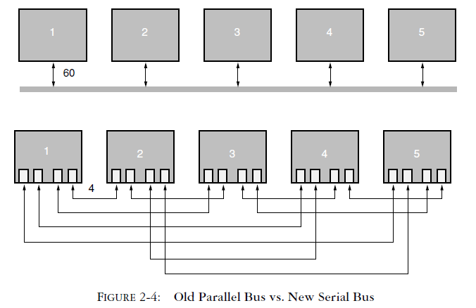
Parallel vs. Serial Backplanes

Slide 45
Serial Backplanes Advantages
Perhaps the most important difference between the two is the bandwidth access method.
In the parallel architectures, one node can transmit to one or many nodes. But while that node is transmitting, all other nodes are blocked. All nodes share the available bandwidth.
In serial buses, each node has a dedicated link to every other node. So one node can talk to one or to all nodes while another node is talking. In fact, all nodes can talk to all other nodes at the same time.

Slide 46
Box-to-Box/Long distance
Usage of Fiber Optics is particularly suited to use with MGTs
Fiber Optic cables can transmit signals for kilometers, and with repeaters the distance is virtually unlimited
This is very hard to do with parallel links and completely uneconomical

Slide 47
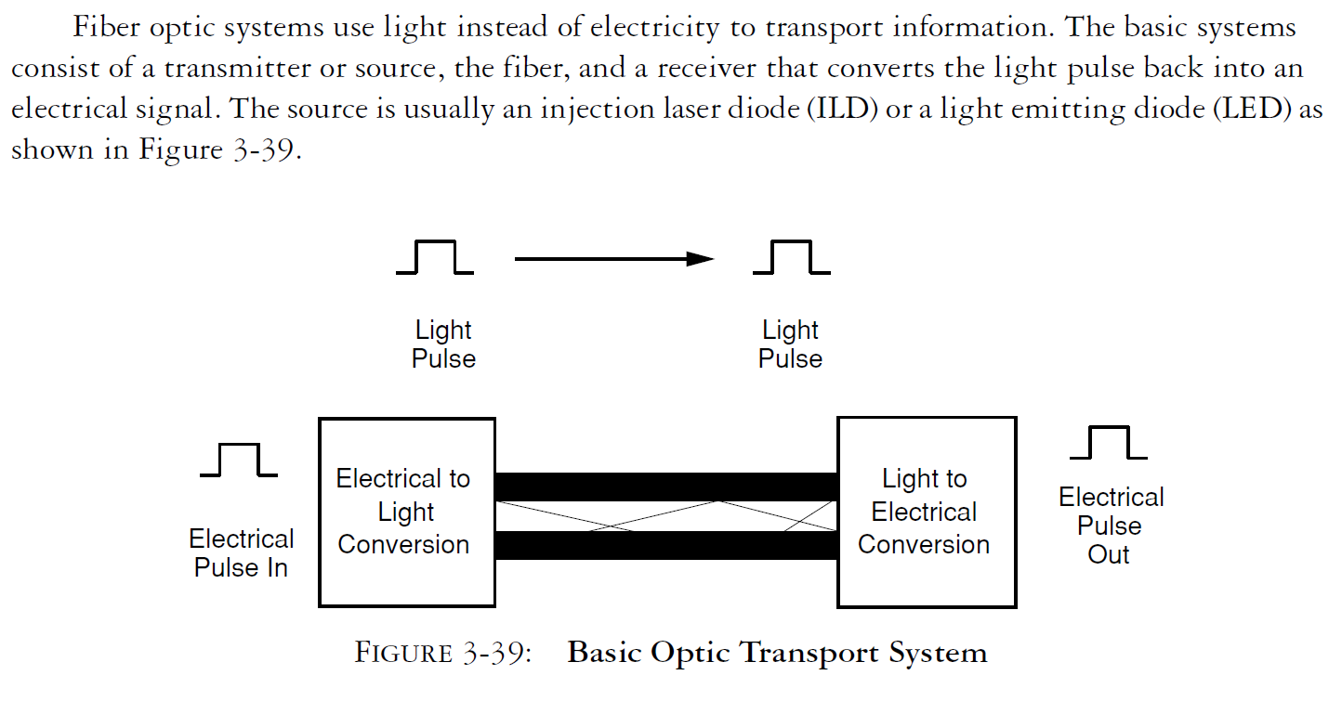
Fiber Optic System Basics

Slide 48
Figure 21-09

Slide 49
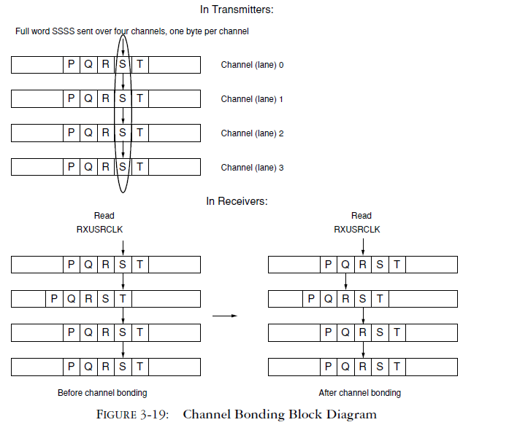
Channel Bonding

Slide 50
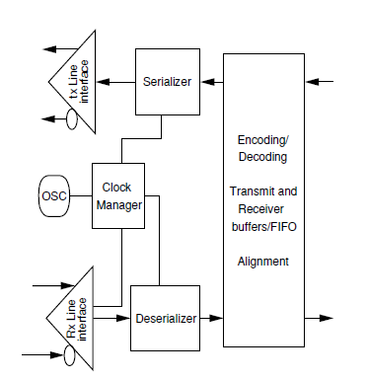
Elements of SERDES

Slide 51
Elements of SERDES

Slide 53
Figure 21-08

Slide 54
Data and Signal: Analog or Digital
Data
Digital data – discrete value of data for storage or communication in computer networks (e.g. computer file)
Analog data – continuous value of data such as sound or image (e.g. photographic film)
Signal
Digital signal – discrete-time signals containing digital information (example: Digital Cable, Wireless Internet)
Analog signal – continuous-time signals containing analog information (example: FM radio)

Slide 55
Line Coding
The purpose of line coding is to transmit the data efficiently through the transmission medium, to facilitate reception by the receiver
Line coding must take into account the frequency response of the medium
Usually FPGAs will use NRZ (Non-Return-to-Zero) because of its simplicity.

Slide 56
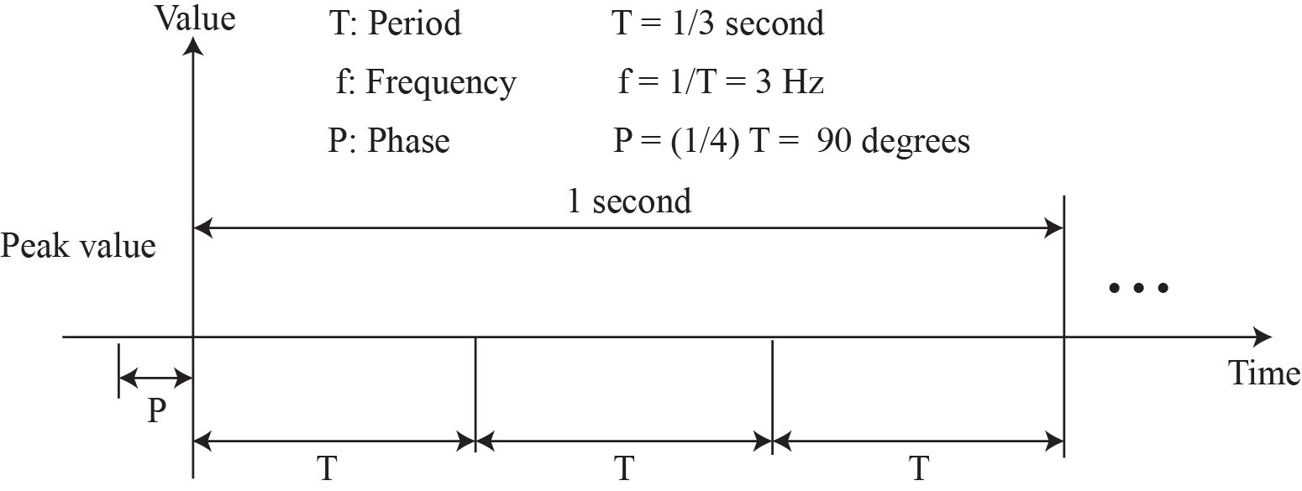
Figure 7.3: A sine wave

Slide 57
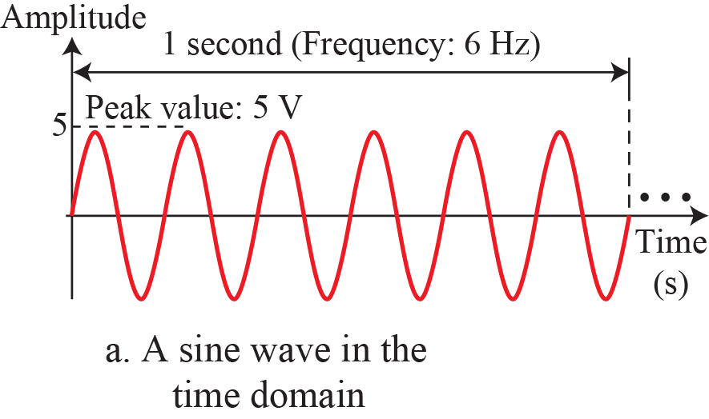
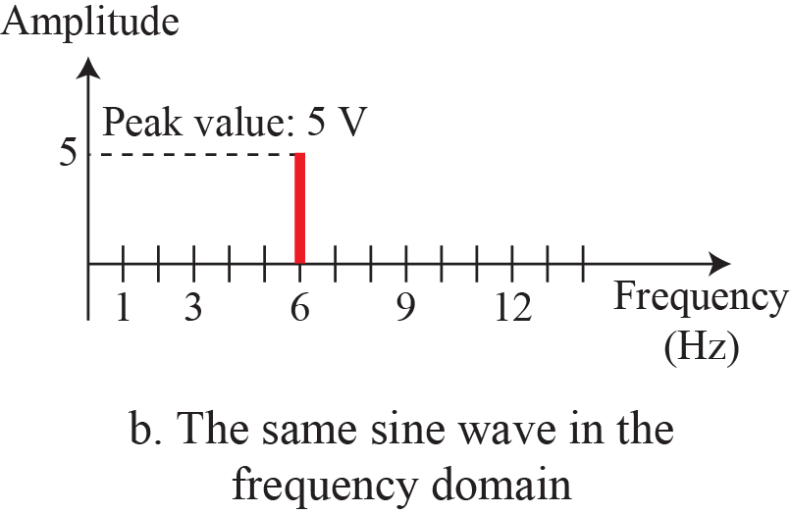
Figure 7.5: The time-domain and frequency-domain plots of a sine wave

Slide 58
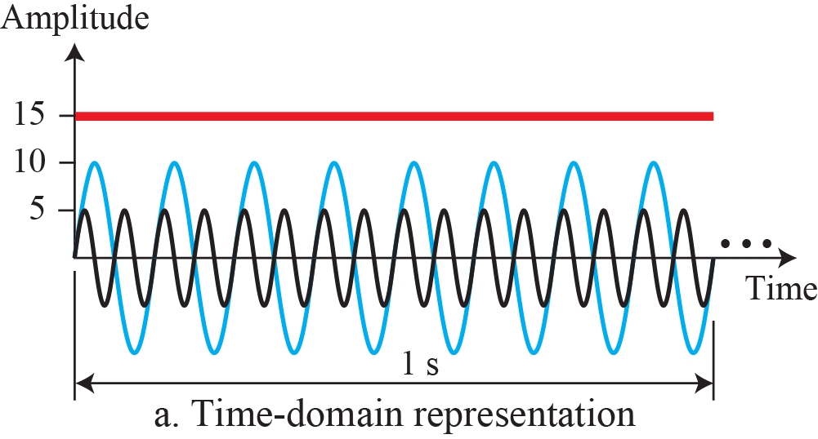
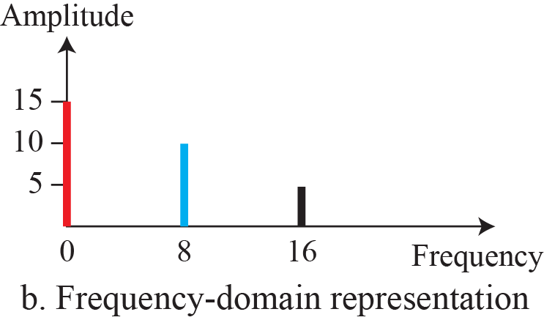
Figure 7.6: The time domain and frequency domain of three sine waves

Slide 59
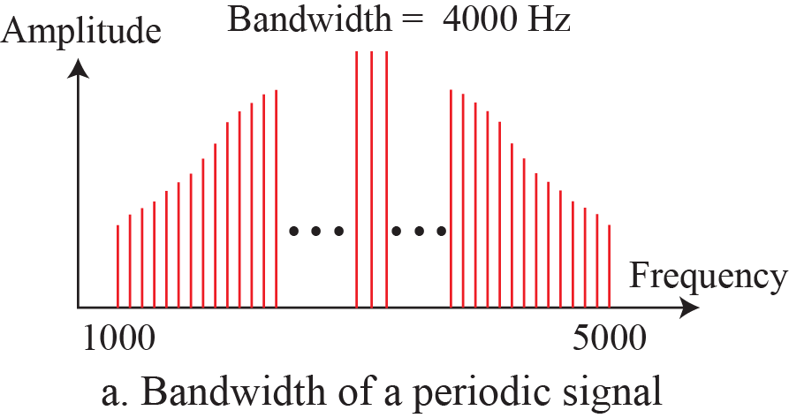
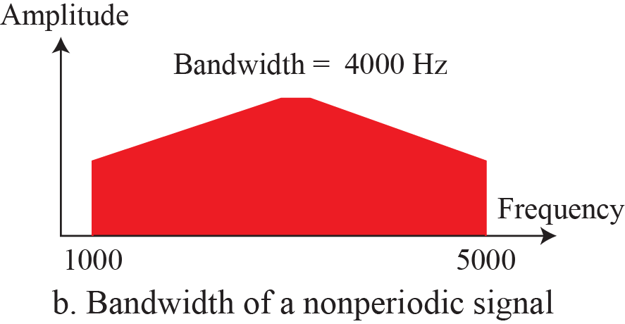
Figure 7.7: The bandwidth of periodic and nonperiodic composite
signals

Slide 60
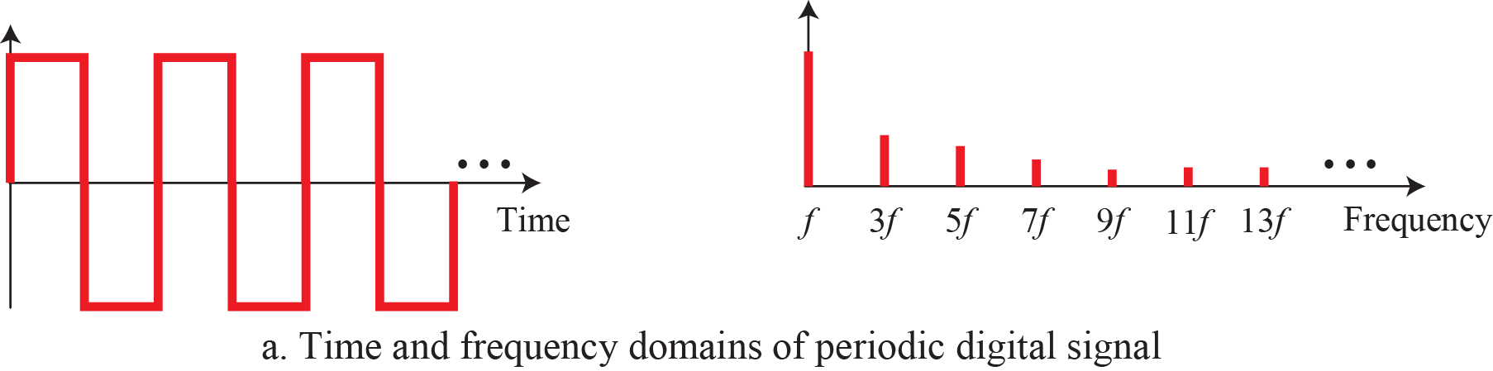
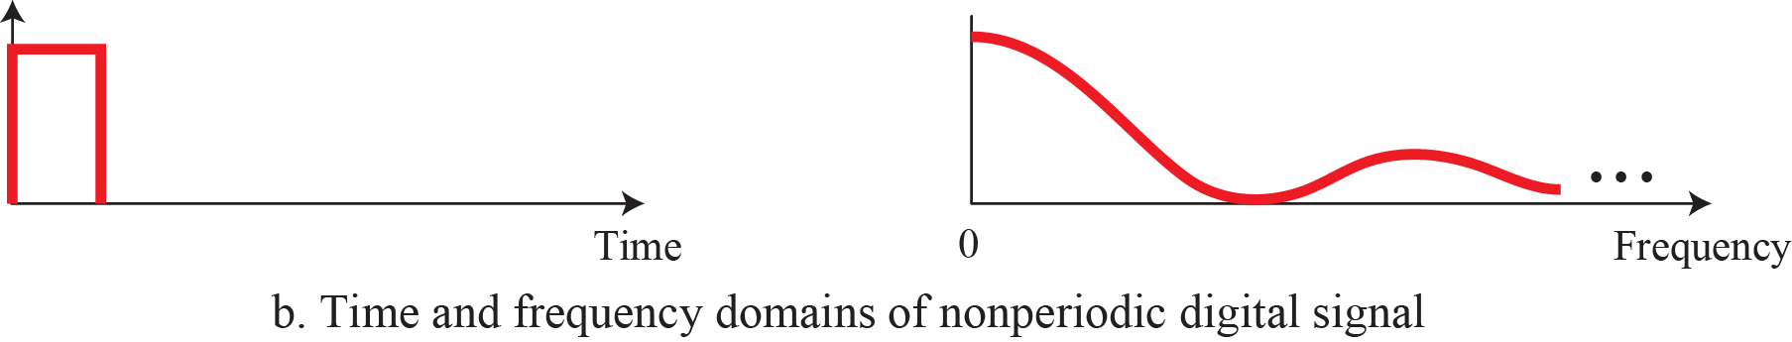
Figure 7.9: The time and frequency domains of periodic and
nonperiodic digital signals

Slide 61
Transmission Impairment
Signals travel through transmission media, which are not perfect. The imperfection causes signal impairment. This means that the signal at the beginning of the medium is not the same as the signal at the end of the medium. What is sent is not what is received. Three causes of impairment are attenuation, distortion, and noise.

Slide 62
Transmission Impairment
(continued)
Attenuation
Distortion
Noise
Signal-to-Noise Ratio (SNR)

Slide 63
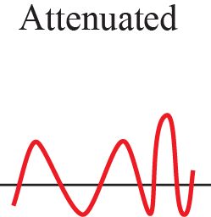
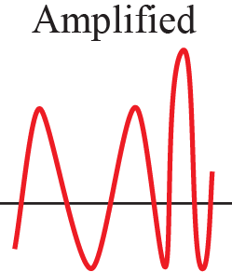
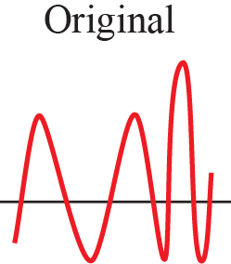
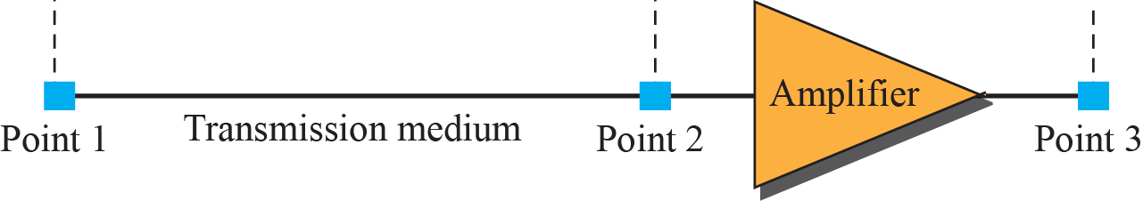
Attenuation and amplification

Slide 64
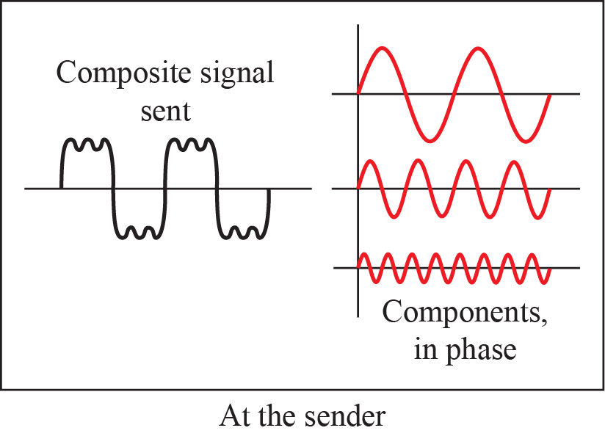
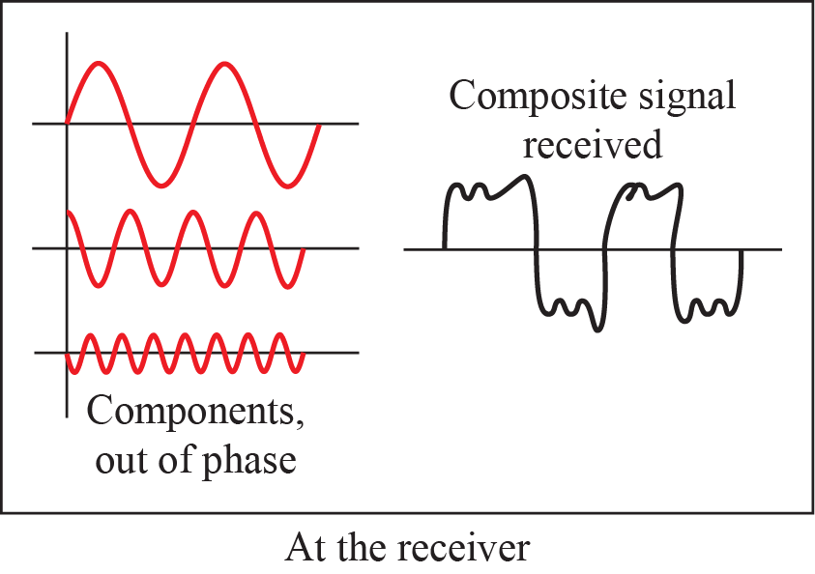
Distortion

Slide 65
Example: Wired Medium: Twisted Pair
Two copper conductor twisted together to prevent electromagnetic interference.
Shielded twisted pairs, STP
Unshielded twisted pairs, UTP.
Metal shield
conductor
Plastic cover
Insulator
conductor
Plastic cover
Insulator

Slide 66
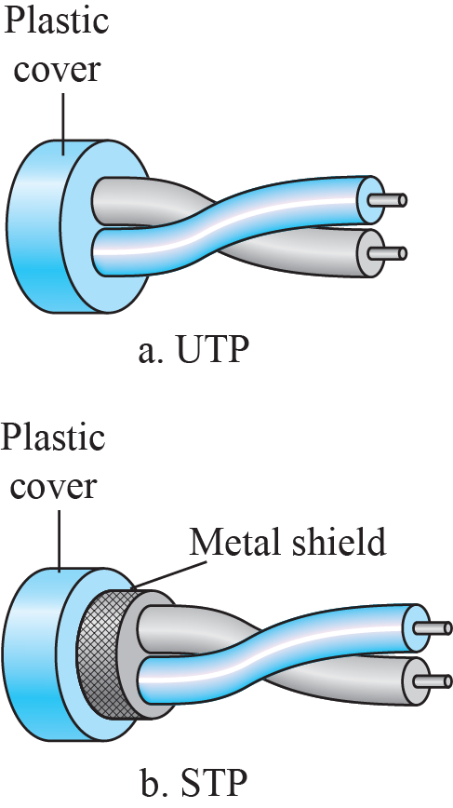
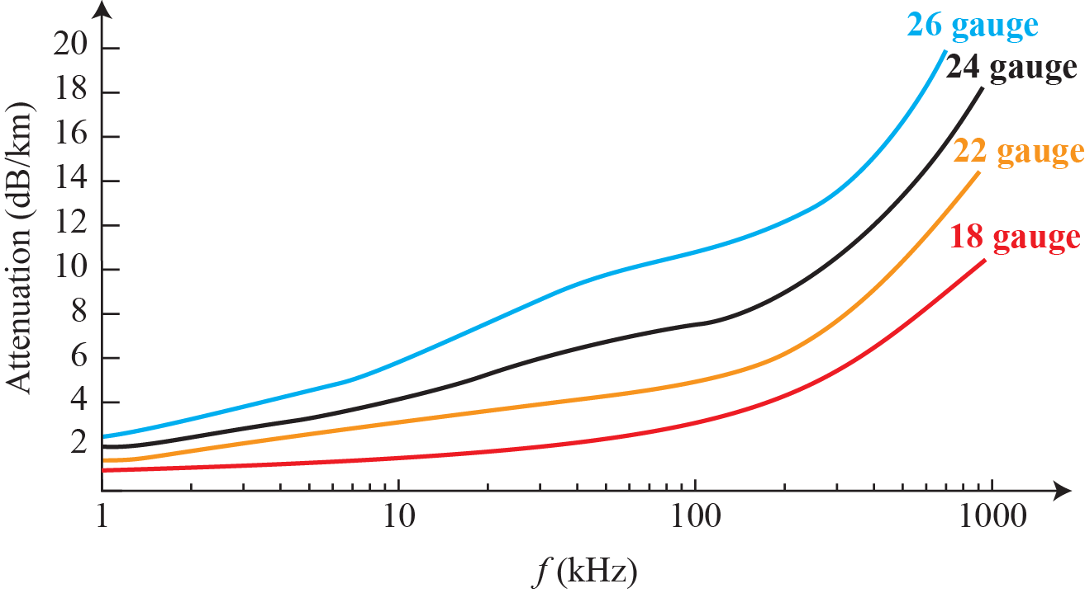
Example: Distortion Due to Twisted-pair cable

Slide 67
Example: Wired Medium: Coaxial Cable
Coaxial Cable
An inner conductor surrounded by an insulating layer, a braided outer conductor, another insulating layer, and a plastic jacket.
Braided
Inner
outer conductor
conductor
Plastic jacket
Insulator
Insulator

Slide 68
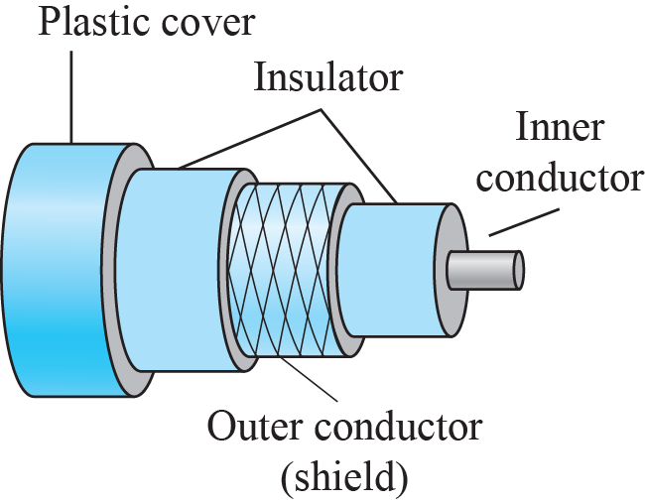
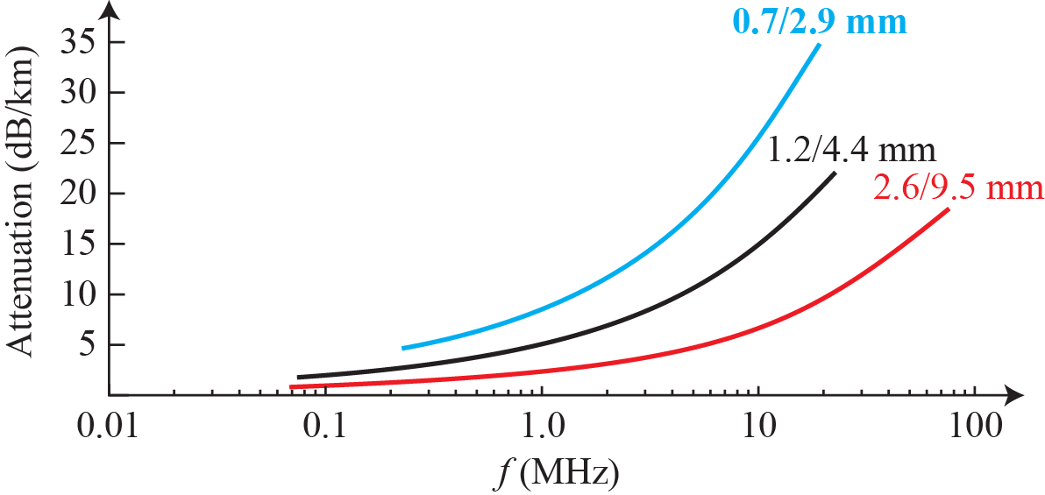
Figure 7.60: Coaxial cable

Slide 69
Example: Wired Medium: Optical Fiber
Optical Fiber: a thin glass or plastic core is surrounded by a cladding glass with a different density.
Cladding
(Glass)
Jacket
Core
(Plastic cover)
(Glass or Plastic)

Slide 70
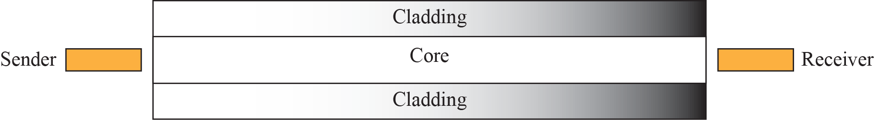
Optical fiber

Slide 71
Wired Medium: Optical Fiber
Single-mode:
A fiber with a very thin core allowing only one mode of light to be carried.
Multi-mode:
A fiber carries more than one mode of light

Slide 72

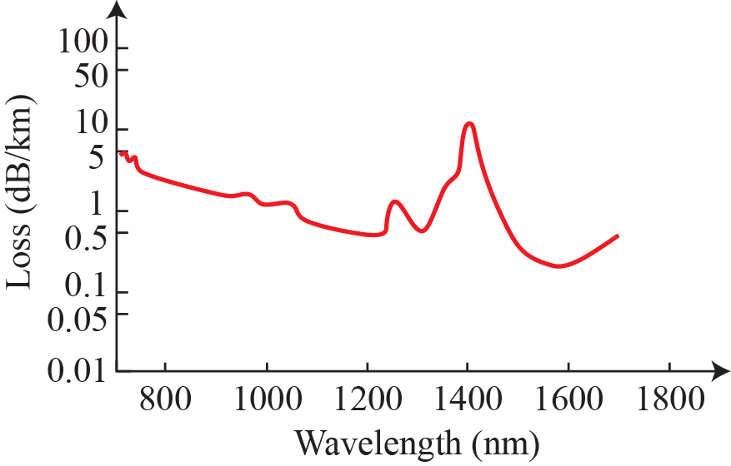


Figure 7.63: Modes

Slide 73
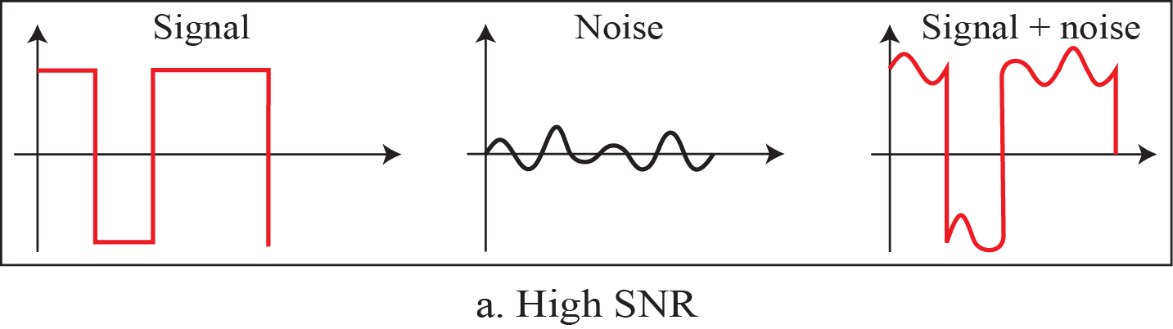
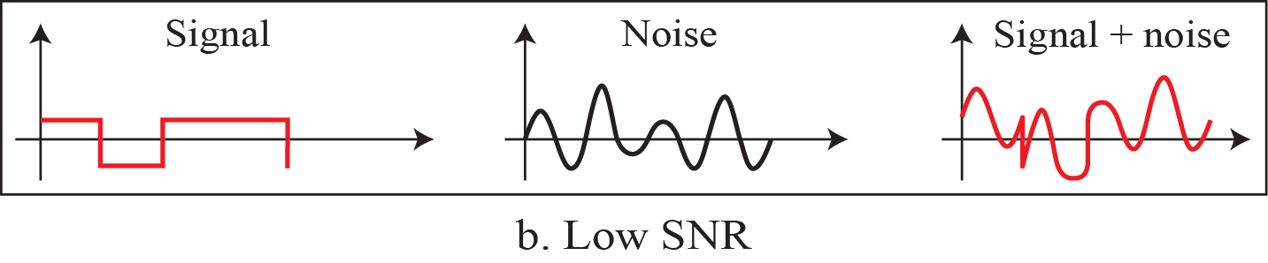
Two cases of SNR: a high SNR and a low SNR

Slide 74
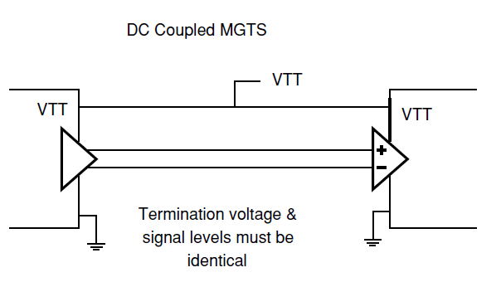
DC coupled MGTs – for short communications between chips on same board only – medium is PCB

Slide 75
MGTs for long distances
Between boards and between boxes we will transmit MGTs over shielded cables or fiber optic cable
Distances can be long, many kilometers sometimes, so there cannot be good assumptions made regarding the voltages and ground of the source and destination systems being equal
Therefore we need to use AC coupling

Slide 76
MGTs with AC coupling

Slide 77
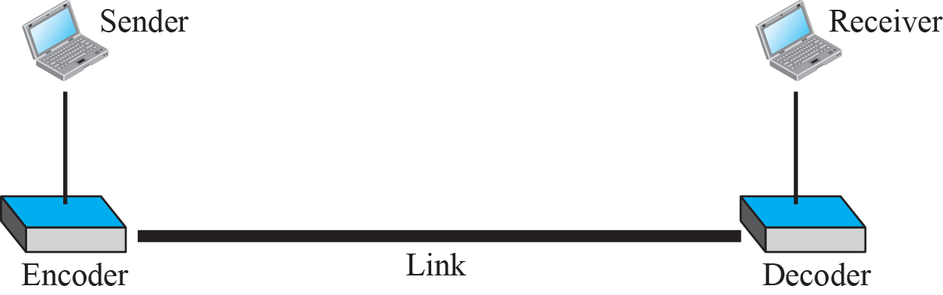
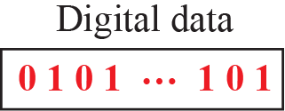
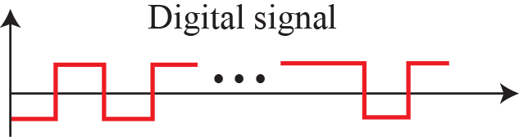
Line coding and decoding

Slide 78
Why line coding is important
We always need to take into account the medium through which our signal passes
If we don’t do that, our signal may be attenuated or distorted beyond any ability to recover it at the receiver.
In particular, with AC coupling, the medium cannot transmit DC
Whatever line coding scheme we use for AC coupled links, it cannot have a DC component

Slide 79
Line Coding Schemes
Unipolar NRZ
Polar NRZ
Polar RZ
Polar Manchester and Differential Manchester
Bipolar AMI and Pseudoternary
Multilevel Coding
Multilevel Transmission 3 Levels
RLL

Slide 80
The spectrum of transmitted signals
In the following slides we will take a look at the spectrum of signals which are transmitted using various line coding schemes
The spectrums assume random data. If the data is not random (e.g. all 1’s, all 0’s or 10101010), the spectrums could be quite different
In reality, block coding and/or scrambling (“whitening”) mechanisms are almost always employed in order to ensure random-looking (“white”) data is transmitted
Random data is also useful from an EMI perspective
Bottom line: the spectrum of the transmitted signal depends on both the line coding scheme and the statistics of the transmitted bits; the latter can be (and usually are) modified by block coding and/or scrambling schemes to produce random-looking data.
One such common block coding scheme is 8b10b that is discussed later

Slide 81
Categories of Line Coding
Category of Line Coding | Line Coding
Unipolar | NRZ
Polar | NRZ, RZ, Manchester, differential Manchester
Bipolar | AMI, Pseudoternery
Multilevel | 2B1Q, 8B6T
Multitransition | MLT3

Slide 82
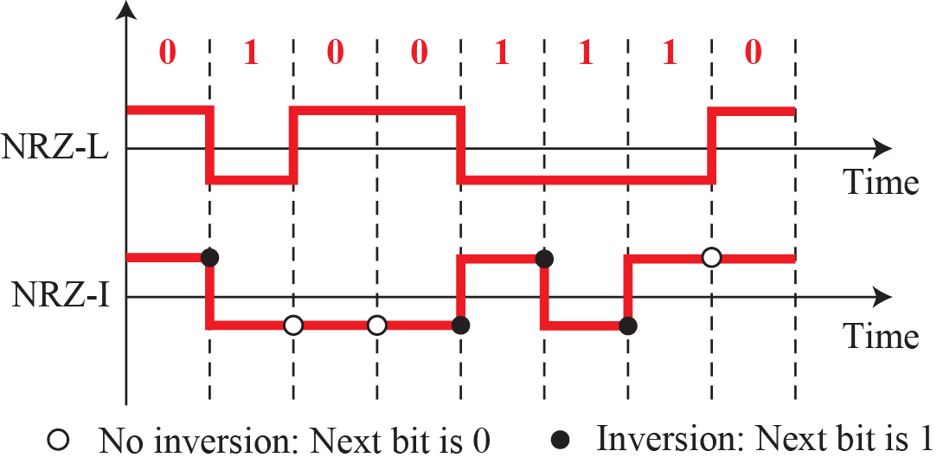
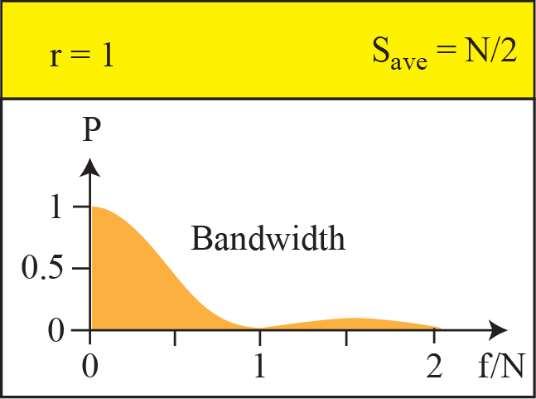
Polar schemes (Part I: NRZ)

Slide 83
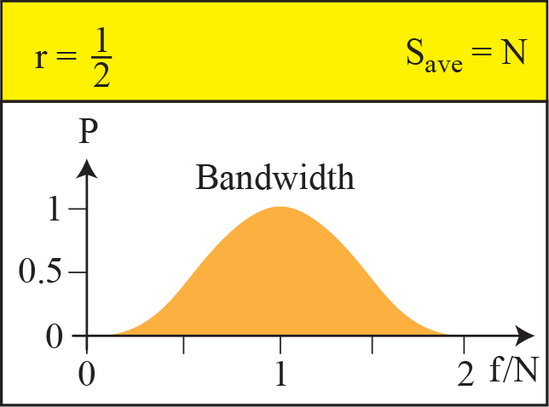
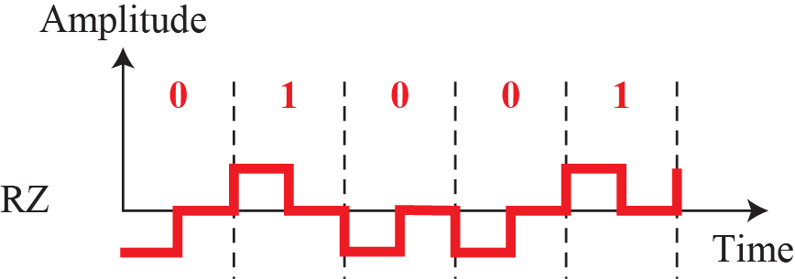
Polar schemes (Part II: RZ)

Slide 84
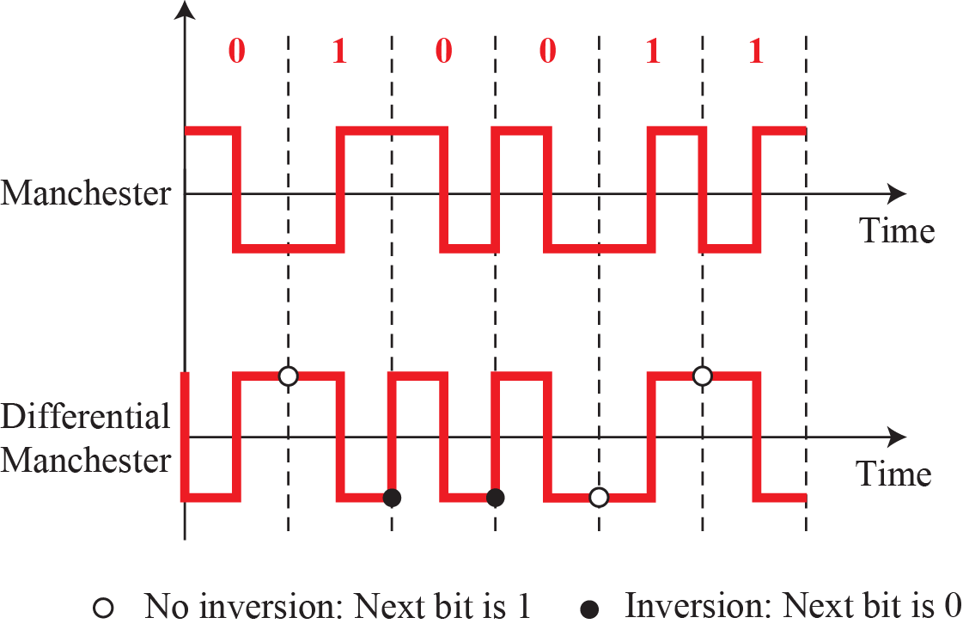
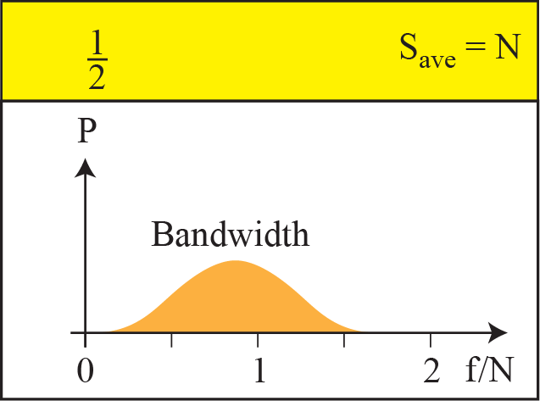
Polar schemes (Part III: Manchesters)

Slide 85
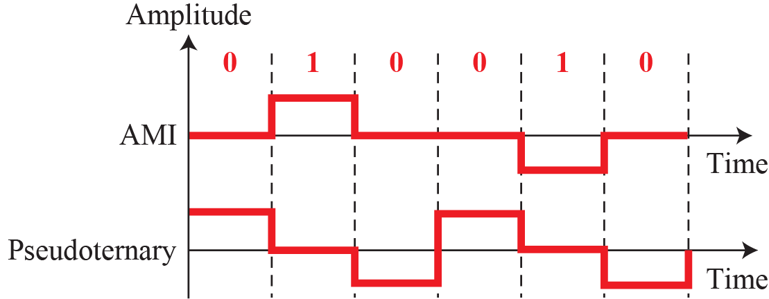
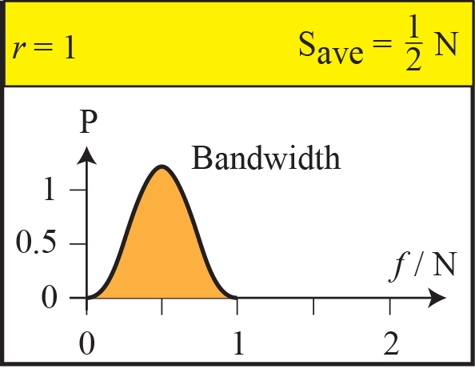
Bipolar schemes: AMI and pseudoternary

Slide 86
The Waveforms of Line Coding Schemes
Clock
1
0
1
0
0
1
1
1
0
0
1
0
Data stream
Unipolar NRZ-L
Polar NRZ-L
Polar NRZ-I
Polar RZ
Manchester
Differential
Manchester
AMI
MLT-3

Slide 87
Bandwidths of Line Coding
The bandwidth of polar NRZ-L and NRZ-I.
The bandwidth of bipolar RZ.

Slide 88
Bandwidths of Line Coding
The bandwidth of Manchester.
The bandwidth of AMI.

Slide 89
Transmission Impairments
Attenuation
Gradual loss in intensity of flux such as radio waves
Distortion: commonly occurs to composite signals
Different phase shifts may distort the shape of composite signals
Interference: usually adds unwanted signals to the desired signal, such as co-channel interference (CCI, or crosstalk), inter-symbol interference (ISI), inter-carrier interference (ICI)
Noise: a random fluctuation of an analog signal, such as electronic, thermal, induced, impulse, quantization noises.

Slide 90
IO Standards

Slide 91
Differential I/O Technologies

Slide 92
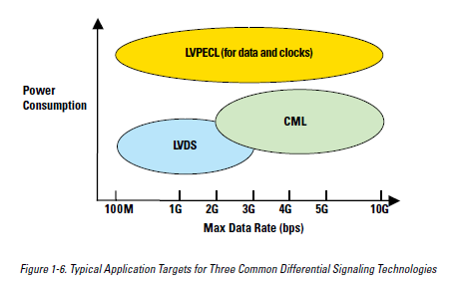
Different Standards for Different Rate and Power Requirements

Slide 93
LVDS Signaling

Slide 94
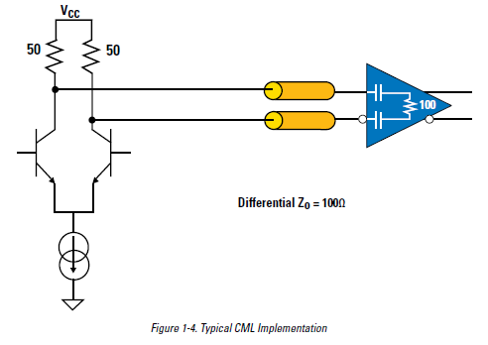
CML (Current Mode Logic) Signaling

Slide 95
LVDS in Source Synchronous Logic

Slide 96
LVDS with embedded clock

Slide 97
Differential IO Technology

Slide 98
Eye Diagram Setup

Slide 99
Eye Diagram - Ideal

Slide 100
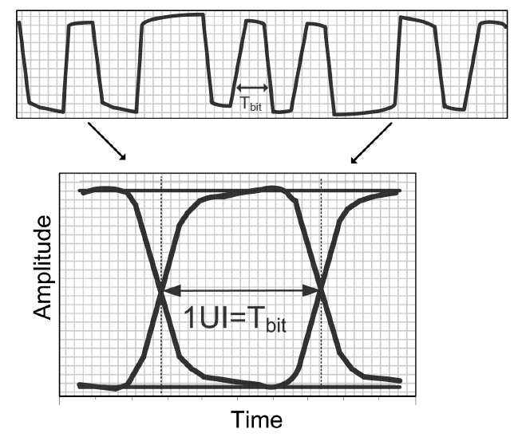
Eye Diagram – with output buffer and medium effects

Slide 101
Eye diagram is pattern dependent (we usually want to optimize for random bits)

Slide 102
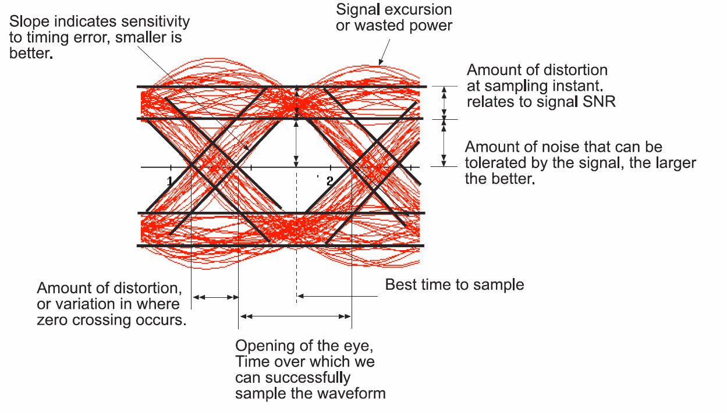
How to interpret an Eye Diagram

Slide 103
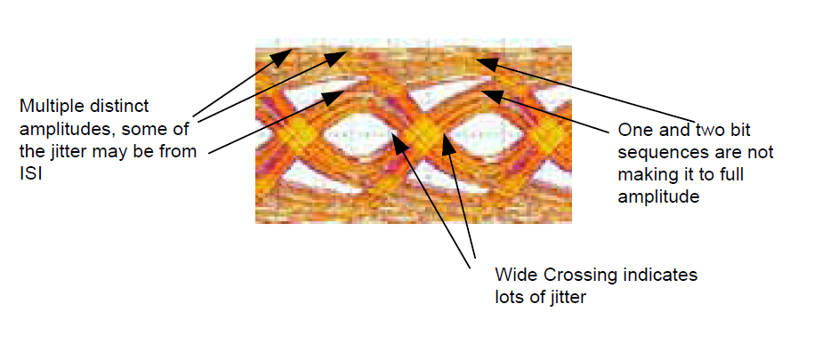
Example of extracting info from eye diagram (1)

Slide 104
Example of extracting info from eye diagram (2)

Slide 105
“Bathtub” curve

Slide 106
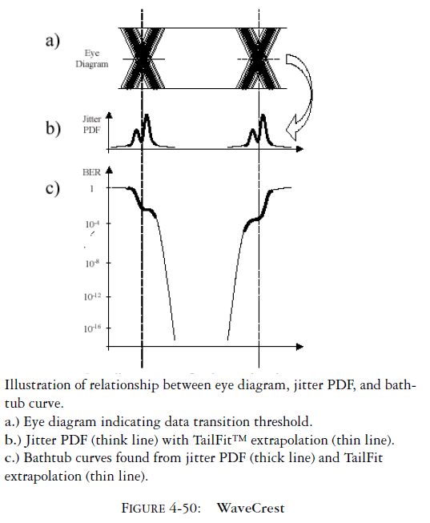
Bathtub curves and eye diagrams are connected

Slide 107
Eye Diagram and BER/Bathtub Curve Correspondence

Slide 109

Eye mask example

Slide 110
Inter-Symbol Interference (ISI)

Slide 111
AC Coupling effect on waveforms

Slide 112
For AC coupled signals: lack of DC balance causes long strings of 1s or 0s to attenuate
1
0
1
0
1
1
0
1
0
1
1
1
1
1
1
1
1
1
?
0
The coupling capacitor along with the termination effectively form a high-pass filter. Long strings of 1s or 0s are low pass signals.
Notes:
112

Slide 113

Example: longer sequence of 1’s in PRBS31 compared to pattern 00111110101100000101

Slide 114
DC Baseline Wander
Figure 21-07

Slide 115
Receiver Automatic Gain Control
Gain
Time
Gain
Again: maximum Run Length
Time
Notes:
115

Slide 116
Combating ISI
Ensure no long sequences of 1’s or 0’s + overall balance of number of 1s and 0s. This is done with coding (e.g. 8b10b coding)
Use pre-emphasis
Use equalization

Slide 117
Preemphasis and Equalization
Preemphasis anticipates which part of the signal will be attenuated/distorted most and applies the reverse gain/distortion
Equalization is adaptive filtering at the receiver which tries to estimate the medium’s channel impulse response and convolve the input signal with an “inverse” filter that neutralizes the medium’s distortions and attenuations.
These are very complicated subjects (particularly equalization)
Modern FPGAs contain both premphasis and equalization circuits in their MGTs

Slide 118
Figure 21-11

Slide 119
Pre-Emphasis
Done at transmitter

Slide 120

Pre-Emphasis
With Preemphasis
Without Preemphasis

Slide 121

Preemphasis - Principle of operation

Slide 122

Preemphasis in the frequency domain

Slide 123

Eye Diagram With and Without Preemphasis

Slide 124


Equalization: Estimate the channel response and add an inverse response to neutralize it
Multiplication of unequalized and equalizer frequency response should give a total frequency response of “1” (on the right, this is “close enough” in the frequency band of interest)

Slide 125

Equalization principle

Slide 126
Effect of Equalization

Slide 127
Preemphasis and Equalization

Slide 128

Reclocking with equalization

Slide 129
Data impairment due to medium

Slide 130

More extreme example: Before

Slide 131
More extreme example: After

Slide 132
Preemphasis and equalization in FPGAs
The transceivers in modern FPGAs have equalization and preemphasis capabilities
Quality of these capabilities is, as expected, price dependent (a Stratix is better than an Arria is better than a Cyclone)
If FPGA’s capabilities are not sufficient, external preemphasis and equalization chips can sometimes be found

Slide 133
Block Coding
Block codes operate on a block of bits. Using a preset algorithm, we take a group of bits and add a coded part to make a larger block. This block is checked at the receiver. The receiver then makes a decision about the validity of the received sequence.
In general, block coding changes a block of m bits into a block of n bits, where n is larger than m. Block coding is referred to as an mB/nB encoding technique.
Block coding can give us this redundancy and improve the performance of line coding.

Slide 134

Figure 7.23: Block coding concept

Slide 135
Examples of block codes are Reed–Solomon codes, Hamming codes, Hadamard codes, Expander codes, Golay codes, and Reed–Muller codes, 8b10b, 4b/5b, 128b/130b. These examples also belong to the class of linear codes, and hence they are called linear block codes.

Slide 136
The importance of Block Codes
We know choosing the proper medium for the bit frequency is essential
We know choosing a proper line code for a given medium is important to avoid excessive attenuation and distortion. In practice, mos
We know that we can partially combat ISI and distortion/attenuation with preemphasis/equalization
But we still need to ensure the data is relatively random and does not include long sequences of 1s or 0s
This is necessary to avoid/mitigate ISI and ensure ability to synchronize (embed the clock within the data)
This is where block codes come in.

Slide 137
Block coding with bounded run-length of 1s or 0s
In practice, most transceivers use NRZ due to simplicity of I/O buffers, and this is important since they operate at such high frequencies
However, NRZ is not ideal for AC-coupled links
One way to combat this is to choose a block code that has a bounded maximum run length of 1s or 0s, to limit ISI degradation
4b/5b and 8b/10b are examples of this

Slide 138

Using block coding 4B/5B with NRZ-I line coding scheme

Slide 139
Self-Synchronization
Some line coding scheme embeds bit interval information in a digital signal (e.g. Manchester)
Some block codes do this too
The received signal can help a receiver synchronize its clock with the corresponding transmitter clock.
The decoder can exactly retrieve the digital data from the received signal if it can recover the clock and the signal is not too corrupted

Slide 140
Figure 21-12

Slide 141
Figure 21-13

Slide 142
Transmission
Use Differential
signalling!
Data
Flip
Flop
D
Q
CDR
Clock
I_{cm}
C
Receiver Threshold is halfway
positive and negative signal
Common mode voltage difference between transmitter and termination at the receiver can result in excessive currents
Use AC Coupling Capacitors…
Need DC Balance!

Slide 143
4B/5B Block Coding
The four binary/five binary (4B/5B) coding scheme was designed to be used in combination with NRZ-I.
Since long sequence of 0s can make the receiver clock lose synchronization. 4B5B maps groups of four bits onto groups of 5 bits, with a minimum density of 1 bits in the output. When NRZI-encoded, the 1 bits provide necessary clock transitions for the receiver.
For example, a run of 4 bits such as 0000 contains no transitions and that causes clocking problems for the receiver. 4B/5B solves this problem by assigning each block of 4 consecutive bits an equivalent word of 5 bits.
The 4B/5B scheme achieves this goal. The block-coded stream does not have more than three consecutive 0s, as we will see later.

Slide 144
At the receiver, the NRZ-I encoded digital signal is first decoded into a stream of bits and then decoded to remove the redundancy. Figure shows the idea.
In 4B/5B, the 5-bit output that replaces the 4-bit input has no more than one leading zero (left bit) and no more than two trailing zeros (right bits). So when different groups are combined to make a new sequence, there are never more than three consecutive 0s.
The 4B5B output is NRZI-encoded.
4B5B was popularized by Fiber distributed data interface (FDDI) in the mid-1980s, and was later adopted by 100BASE-TX standard defined by IEEE 802.3u in 1995.

Slide 145
4B/5B Encoding Table
Name | 4B | 5B | description
0 | 0000 | 11110 | hex data 0
1 | 0001 | 01001 | hex data 1
2 | 0010 | 10100 | hex data 2
3 | 0011 | 10101 | hex data 3
4 | 0100 | 01010 | hex data 4
5 | 0101 | 01011 | hex data 5
6 | 0110 | 01110 | hex data 6
7 | 0111 | 01111 | hex data 7
8 | 1000 | 10010 | hex data 8
9 | 1001 | 10011 | hex data 9
A | 1010 | 10110 | hex data A
B | 1011 | 10111 | hex data B
C | 1100 | 11010 | hex data C
D | 1101 | 11011 | hex data D
E | 1110 | 11100 | hex data E
F | 1111 | 11101 | hex data F
Q | n/a | 00000 | Quiet (signal lost)
I | n/a | 11111 | Idle
J | n/a | 11000 | Start #1
K | n/a | 10001 | Start #2
T | n/a | 01101 | End
R | n/a | 00111 | Reset
S | n/a | 11001 | Set
H | n/a | 00100 | Halt

Slide 146
The Combination of 4B/5B Coding and NRZ-I Coding
the technique 4B/5B may eliminate the NRZ-I synchronization problem

Slide 147

5B/6B code

Slide 148

3B/4B code

Slide 149
8B/10B Encoder (1/2)
Widely adopted by a variety of high-speed data communication standards, such as
PCI Express
IEEE 1394b
serial ATA
Gigabit Ethernet
Provides
DC – balance
Clock synchronization
Rudimentary Scrambling (not secure but better for EMI purposes than the original data)

Slide 150


History of 8B/10B coding

Slide 151
8B/10B Encoder (2/2)
Block diagram of 8B/10B Encoder

Slide 152

Encoder implemented with Block Ram

Slide 153

8b10b Encoder

Slide 154
Decoder implemented with block ram (easier to understand but less efficient)

Slide 155

More efficient 8b10b Decoder

Slide 156

8b10b encoding/decoding is resource efficient and practical

Slide 157


8B/10B coding
Maximum run length = 5
Running Disparity => DC Balance
8 bits => 256 different values
10 bits => 1024 different values
8B10B code is built out of:
(5 to 6 bit code) + (3 to 4 bit code)

Slide 158

8B/10B coding
Not all 1024 values are useful.
For example “0100000011” has run length 6
For most of the 256 (8B) values a positive and a negative 10B value is selected depending on the “Current Running Disparity”
For example:
D7.0 = 1110001011 (Current RD-)
D7.0 = 0001110100 (Current RD+)
So about 512 useful values are selected from 1024…
There are still a few codes left!

Slide 159

8b10b Data and Control Symbols

Slide 160

Running Disparity FSM

Slide 161

8b10b Data and Control Symbols

Slide 162

8B/10B coding table
256 “Data” Characters:

Slide 163


Slide 164

8B/10B coding table
There were still a few codes left!
12 “Special” K Characters:
Comma
Characters
“The only patterns that
have 5 consecutive
‘1’s or ‘0’s

Slide 165
8B/10B code “K” Characters
010101001101100111000001010110111010010100100111010011001001110100111001
010101001101100111000001010110111010010100100111010011001001110100111001
??.?
K28.5
D16.2
D31.3
D11.3
D0.0
Comma characters K28.1/K28.5/K28.7 are used word alignment
Create “ordered sets”
For example Fibre Channel Start Of Frame (SOF) = K28.5/D21.5/D23.0/D23.0
K30.7 = Error Propagate
K28.3 = Carrier Extend

Slide 166

Transceivers in FPGAs

Slide 167

Basic Stratix IV Transceiver Block

Slide 168
Case Study: 1Gbit/Sec Ethernet
Here we will analyze the 1Gbit/Sec Ethernet standard that is sent over a copper cable or fiber optic cable
The bits are serialized to 1.25 Gbit/Sec
We shall move from the transceiver all the way to the software

Slide 169
PROTOCOL LAYERING
A word we hear all the time when we talk about the Internet is protocol. A protocol defines the rules that both the sender and receiver and all intermediate devices need to follow to be able to communicate effectively. When communication is simple, we may need only one simple protocol; when the communication is complex, we need a protocol at each layer, or protocol layering.
1.169
Notes:
1.#

Slide 170

A single-layer protocol
1.170
Notes:
1.#

Slide 171






A three-layer protocol
1.171
Notes:
1.#

Slide 172

Logical connection between peer layers
1.172
Notes:
1.#

Slide 173
TCP/IP Protocol Suite
TCP/IP is a protocol suite used in the Internet today. It is a hierarchical protocol made up of interactive modules, each of which provides a specific functionality. The term hierarchical means that each upper level protocol is supported by the services provided by one or more lower level protocols. The original TCP/IP protocol suite was defined as four software layers built upon the hardware. Today, however, TCP/IP is thought of as a five-layer model.
Notes:
1.#

Slide 174
TCP/IP Protocol Suite (continued)
Layered Architecture
Description of Each Layer
Application Layer
Transport Layer
Network Layer
Data-link Layer
Physical Layer
1.174
Notes:
1.#

Slide 175


Communication through an internet
1.175
Notes:
1.#

Slide 176


Logical connections between layers in TCP/IP
Logical connections
1.176
Notes:
1.#

Slide 177

Identical objects in the TCP/IP protocol suite
Identical objects (messages)
Identical objects (segment or user datagram)
Identical objects (datagram)
Identical objects (datagram)
Identical objects (frame)
Identical objects (frame)
Identical objects (bits)
Identical objects (bits)
1.177
Notes:
1.#

Slide 178








Encapsulation / Decapsulation
1.178
Notes:
1.#

Slide 179


Figure 1.17: Addressing in the TCP/IP protocol suite
1.179
Notes:
1.#

Slide 180


Multiplexing and demultiplexing
Notes:
1.#

Slide 181


Ethernet frame

Slide 182

Case study: Altera 1Gbit/sec Ethernet

Slide 183

Connection to MAC

Slide 184

Serialization/Deserialization

Slide 185

SGMII PCS (Physical Coding Sublayer)

Slide 186
MAC Functional Diagram (note CRC)

Slide 187

MAC Frame Retransmission – note the LFSR

Slide 188

Connection to Software, Nios, and Qsys

Slide 189

The Altera DE2 Board

Slide 190

The Altera DE1-SoC Board

Slide 191

Transceivers Physical Connection

Slide 192
MicroC/OS-II Real Time Operating System (RTOS)
MicroC/OS-II RTOS is a small, multi-threaded real-time operating systems
It is fully supported by Altera with push-button synthesis
The code base (in C) is small and accessible
Device drivers are automatically generated

Slide 193
Software Architecture of an Altera NIOS MicroC/OS-II RTOS System

Slide 194
NicheStack TCP/IP Stack
The NicheStack TCP/IP Stack is an open-source networking stack written in C
It is small and accessible, but nonetheless is very complete
Includes support for, among other protocols, TCP, UDP, IPv4, IPv6, FTP (client and server), Telnet (client and server), HTTP client, DNS, DHCP, ARP, ICMP…
Uses industry-standard Berkeley Sockets API

Slide 195

Layers of an Altera/MicroC OS-II/ NicheStack Networking System

Slide 196
Conclusions
We have learned about transceivers in FPGAs
We have learned about line coding and block coding
We studied the 8b/10b code
We studied the 1Gbit/Sec Ethernet Standard
Transceivers are a very important part of modern FPGAs and every FPGA engineer needs to know how to use them

